Slide 1
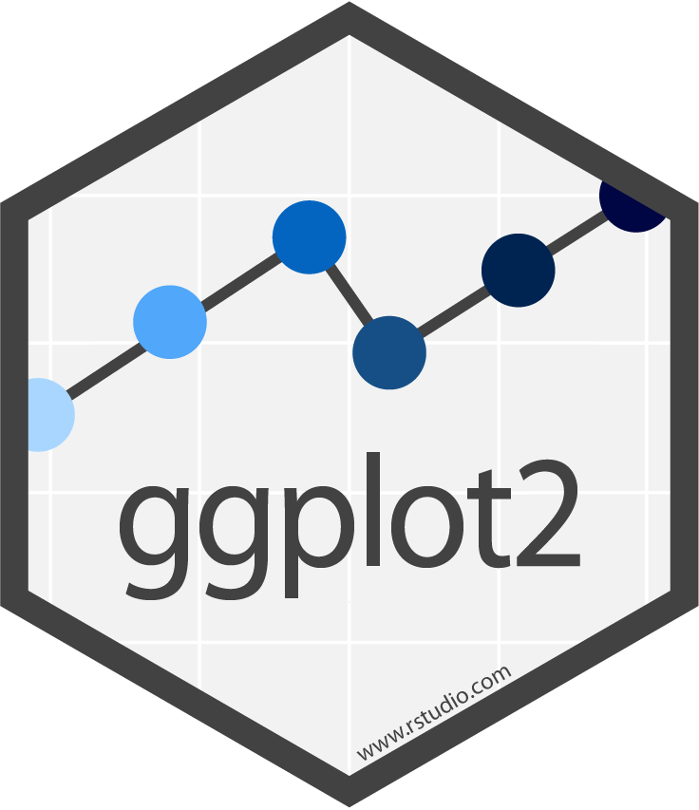

Introduction to ggplot2 package
Felipe Dalla Lana, Ph.D.

Slide 2

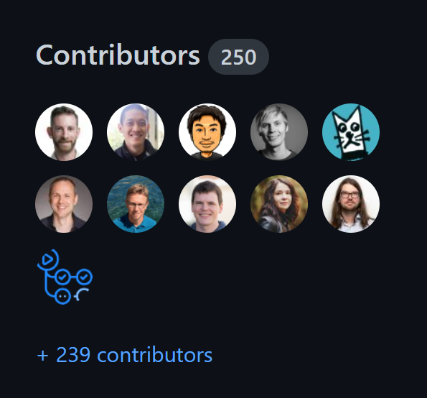
What is ggplot2
First released - July of 2007
40 version since
Authors of current version (3.3.3)
Hadley Wickham
Winston Chang
Lionel Henry
Thomas Lin Pedersen
Kohske Takahashi
Claus Wilke
Kara Woo
Hiroaki Yutani
Dewey Dunnington
Hadley Wickham
Chief Scientist at Rstudio
University of Auckland
Stanford University
Rice University

Slide 3
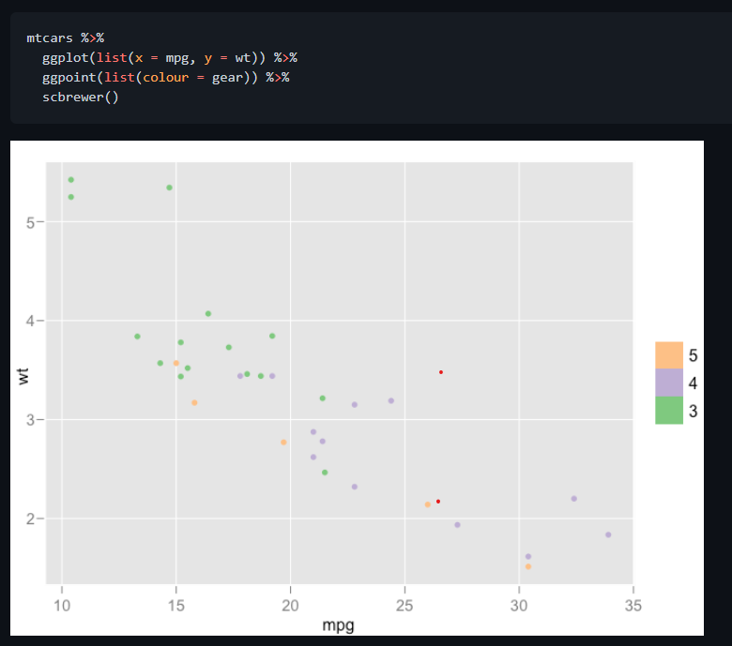
How about ggplot1?
April 2006 v. 0.2.2
October 2008 v. 0.4.2

Slide 4
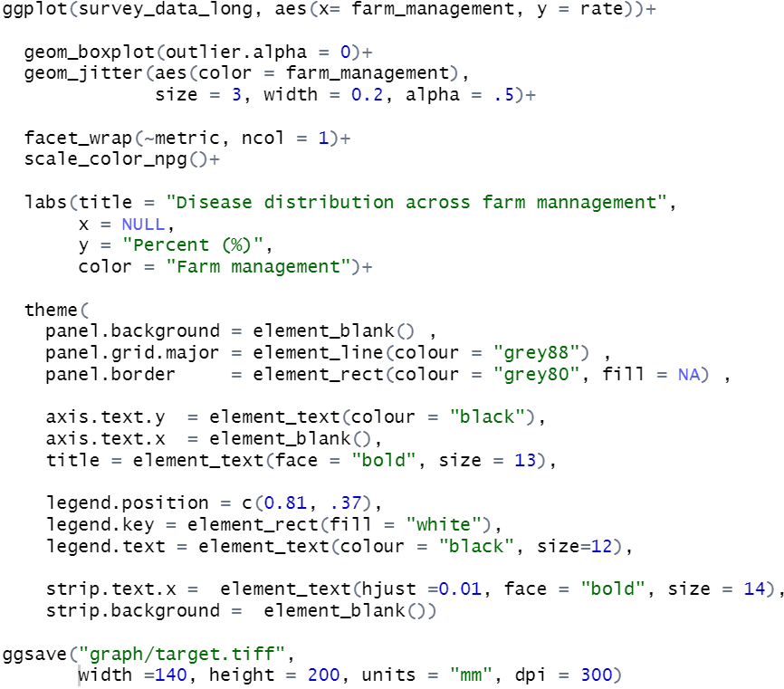
The package grammar
ggplot function and
data
Geometric elements
Aesthetic mappings
Facets, scale, labs, coordinates
Theme
Save

Slide 5
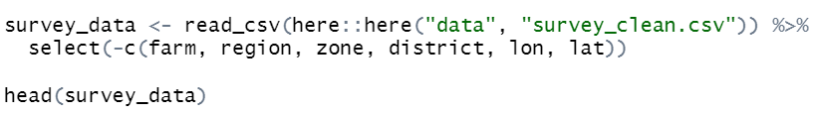
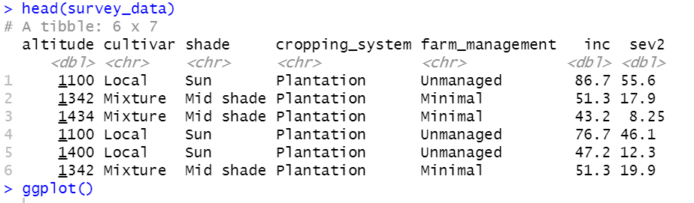
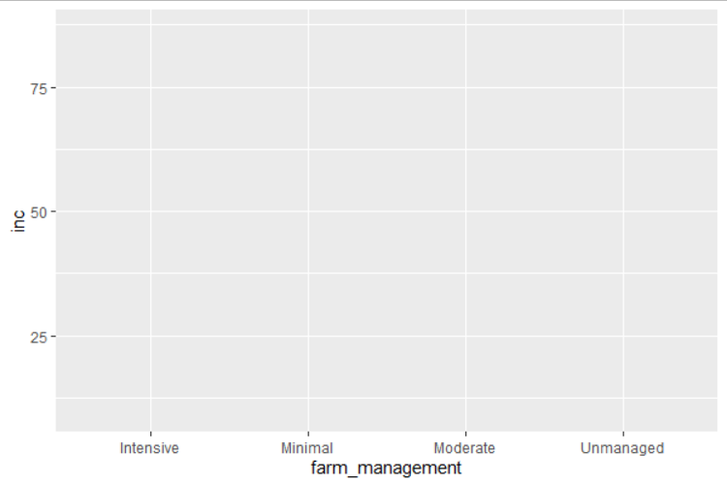


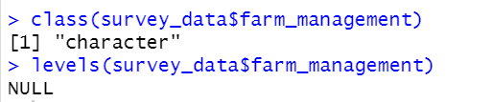
Data and ggplot function

Slide 6
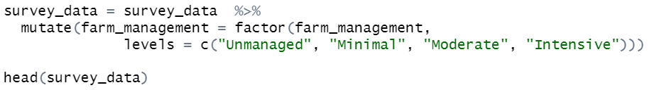
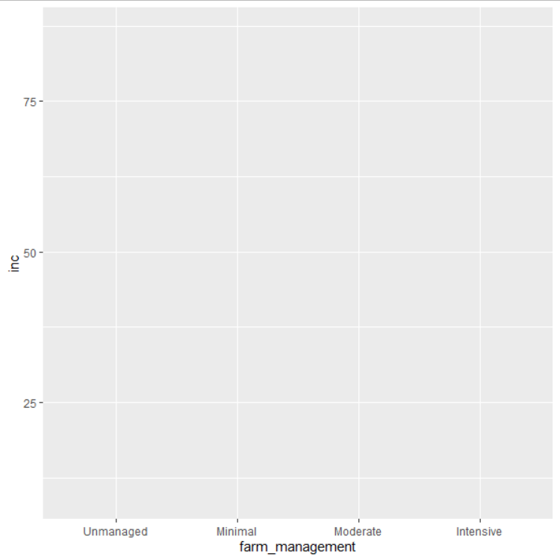
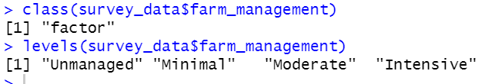
Data and ggplot function

Slide 7
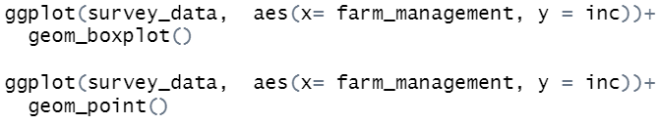
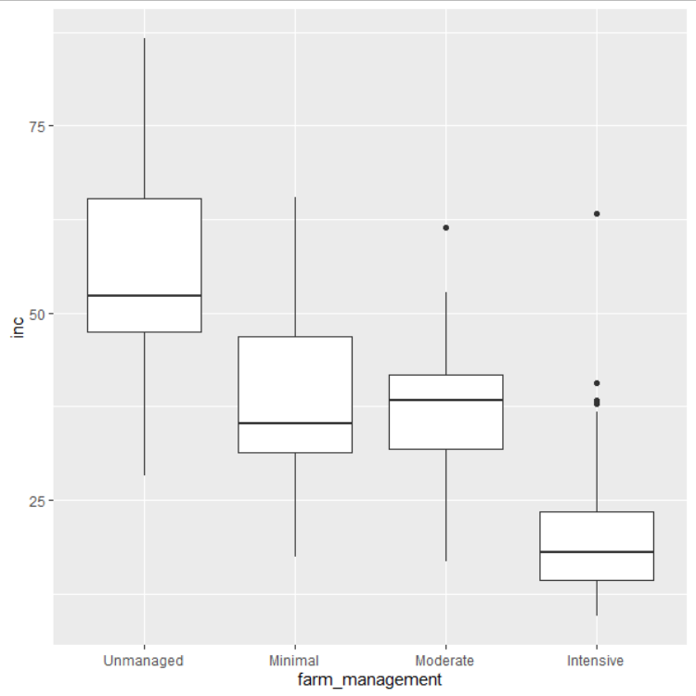
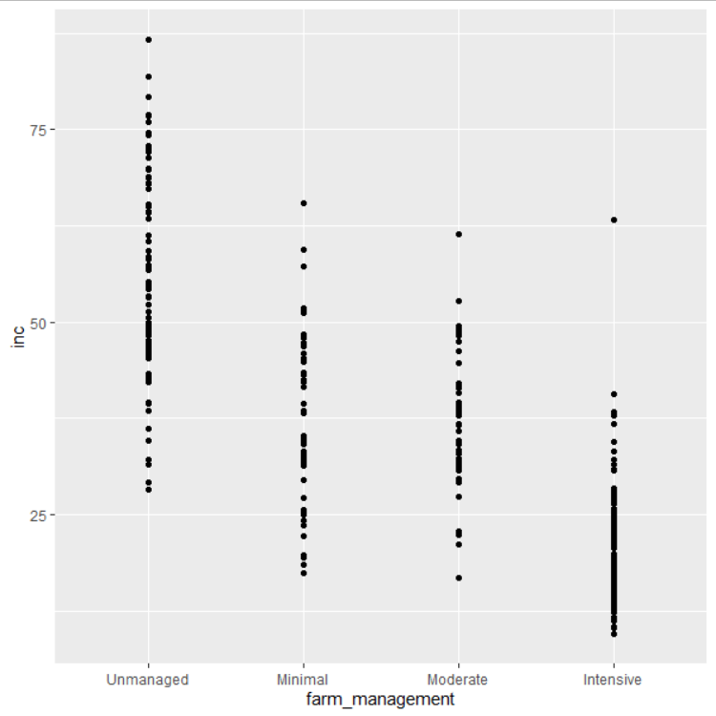
Geometric elements

Slide 8
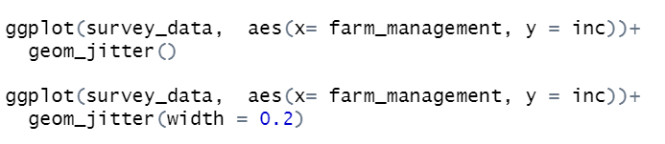
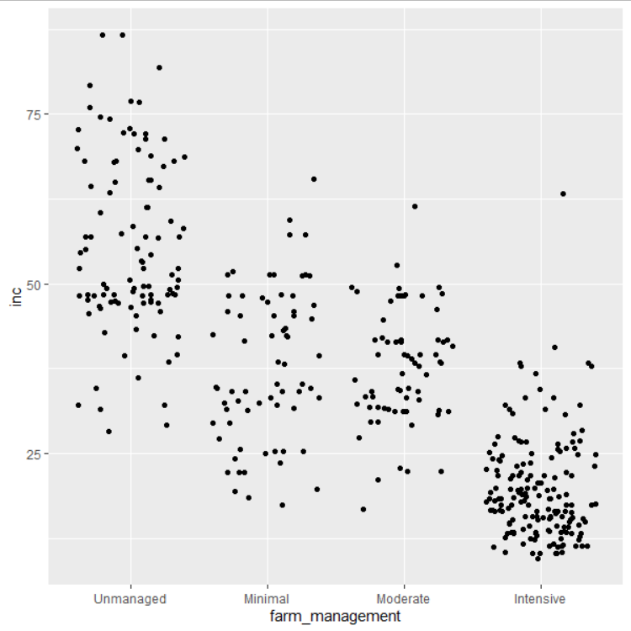
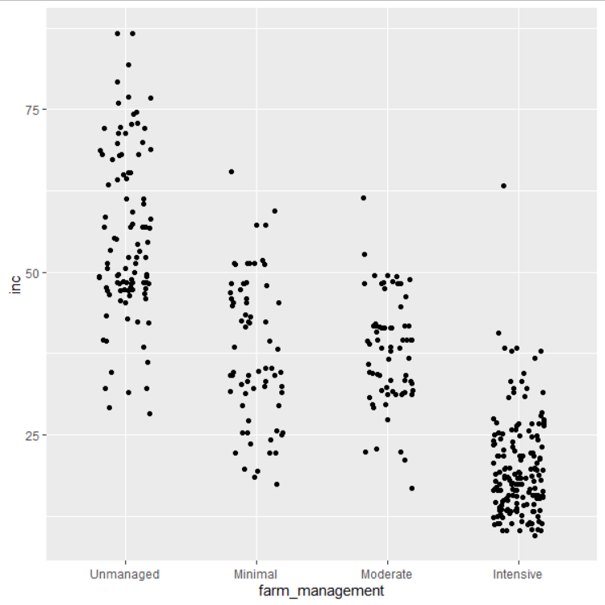
Geometric elements

Slide 9
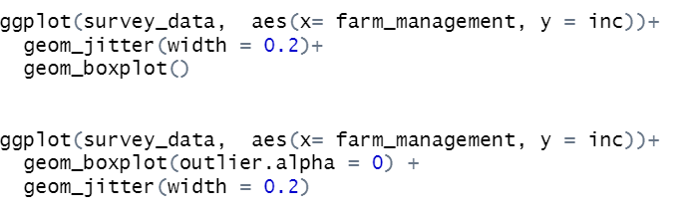
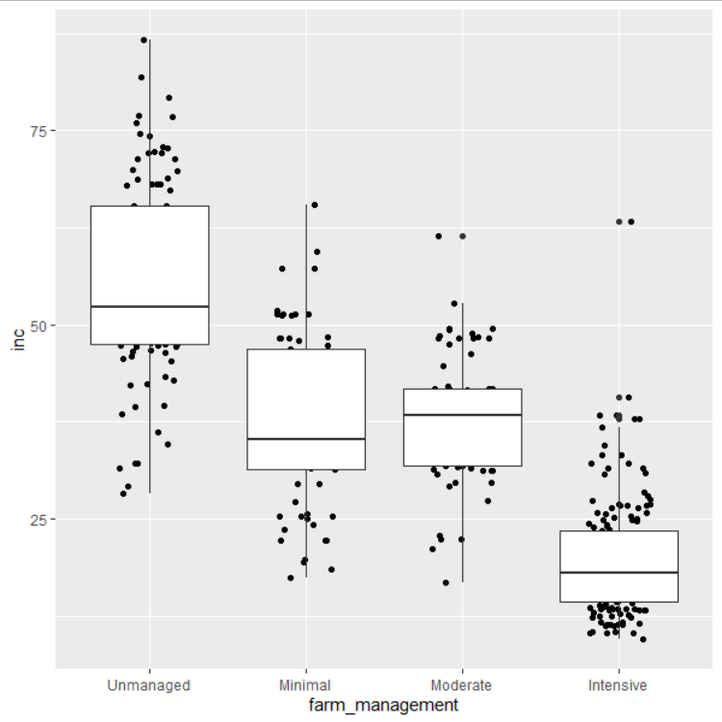
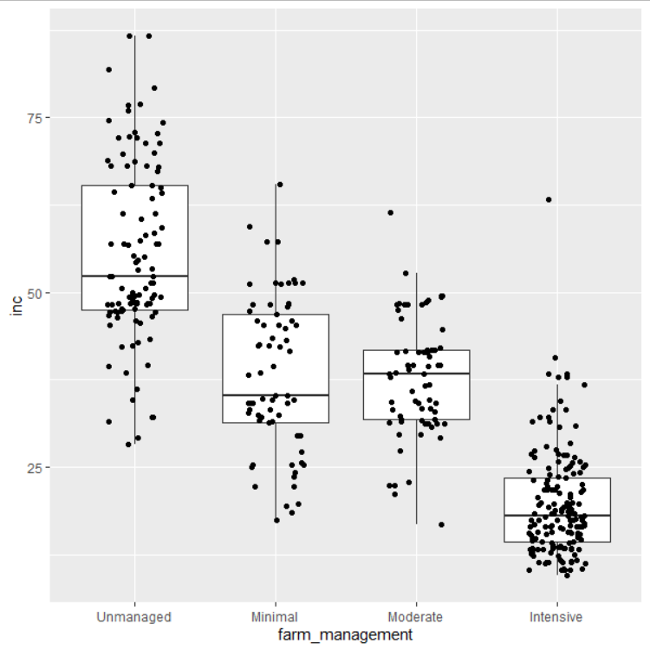
Geometric elements

Slide 10
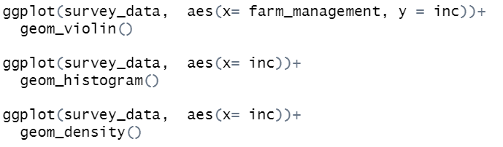
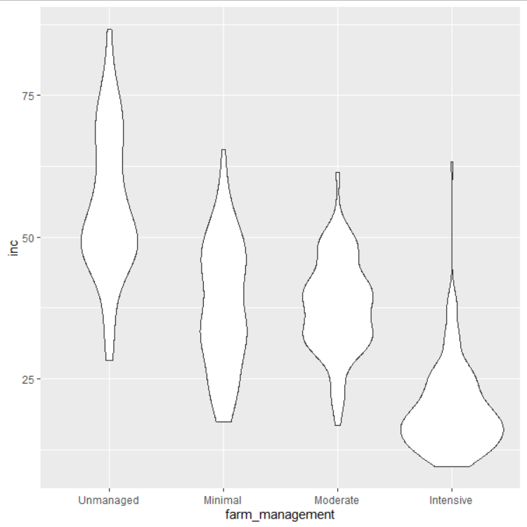
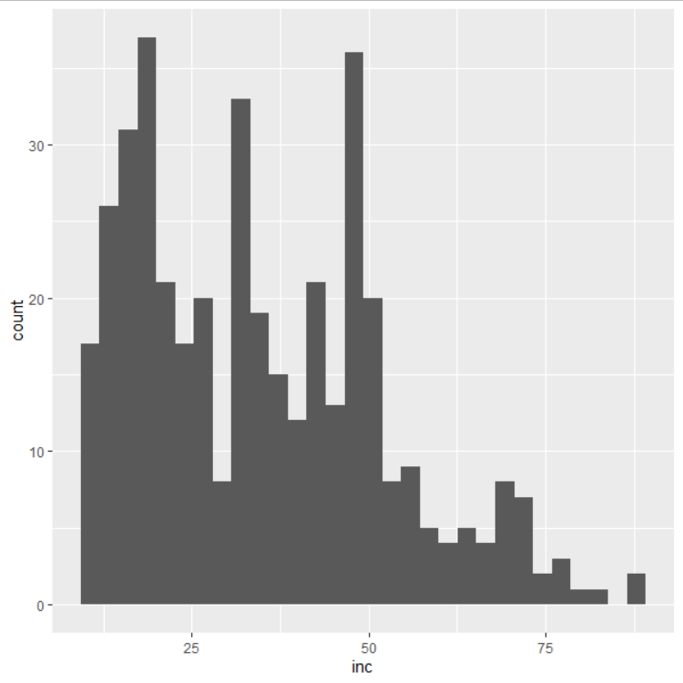
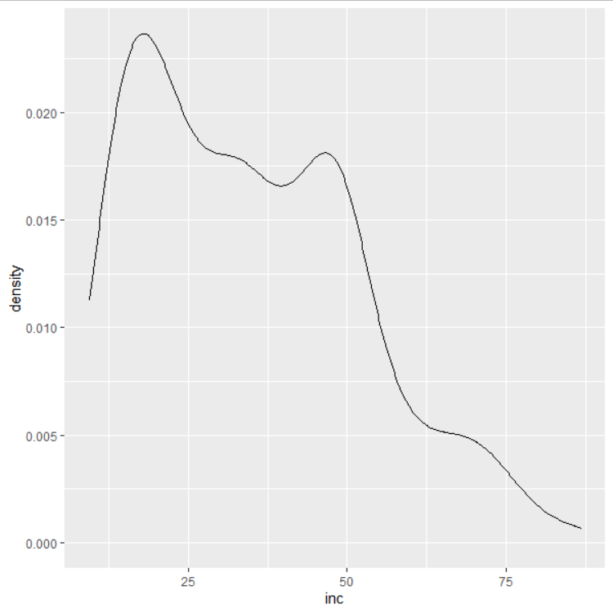
Geometric elements
geom_violin()
geom_histogram()
geom_density()

Slide 11
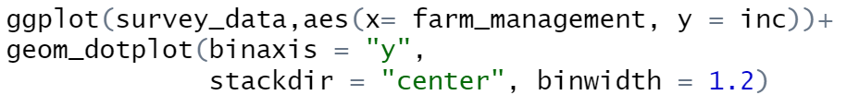
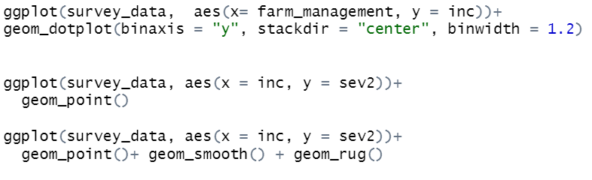
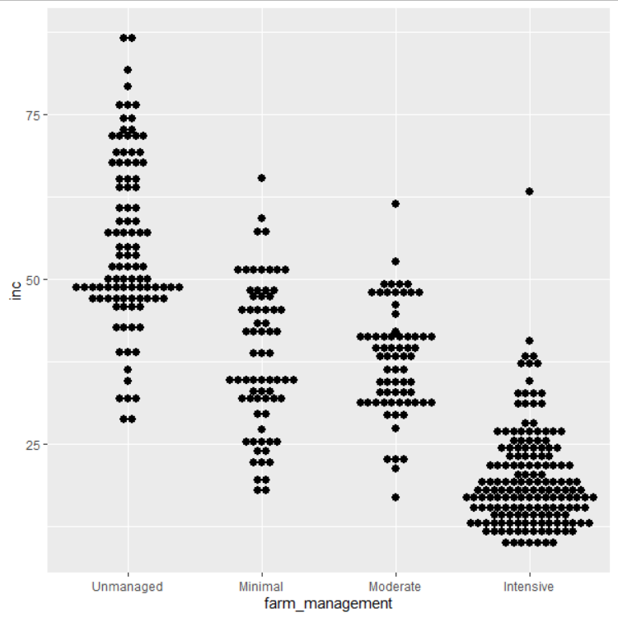
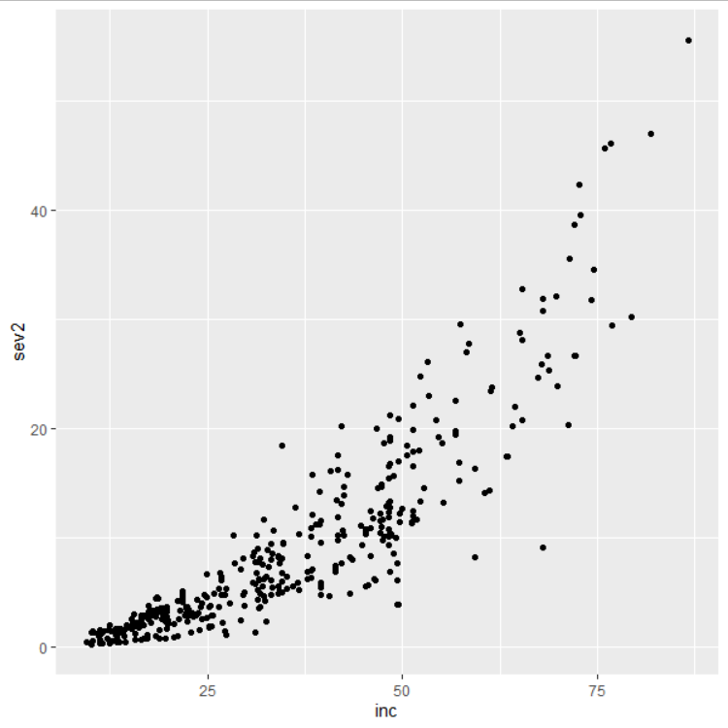
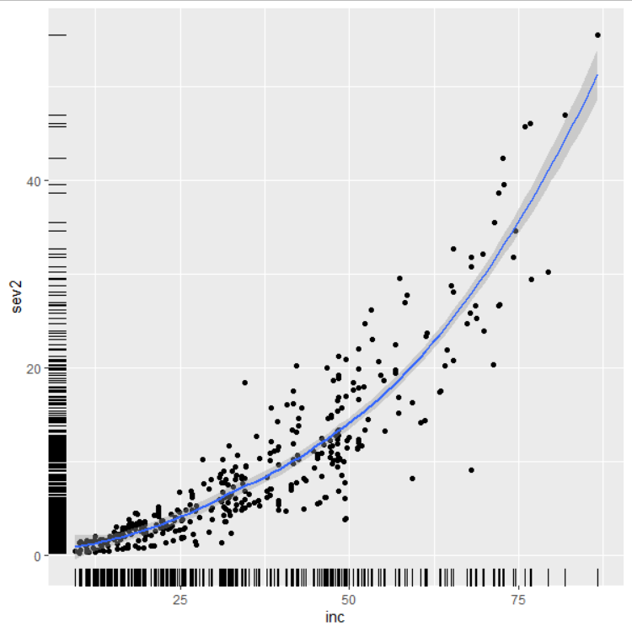
Geometric elements
geom_point()+ geom_smooth()+
geom_rug()
geom_dotplot()
geom_point()

Slide 12
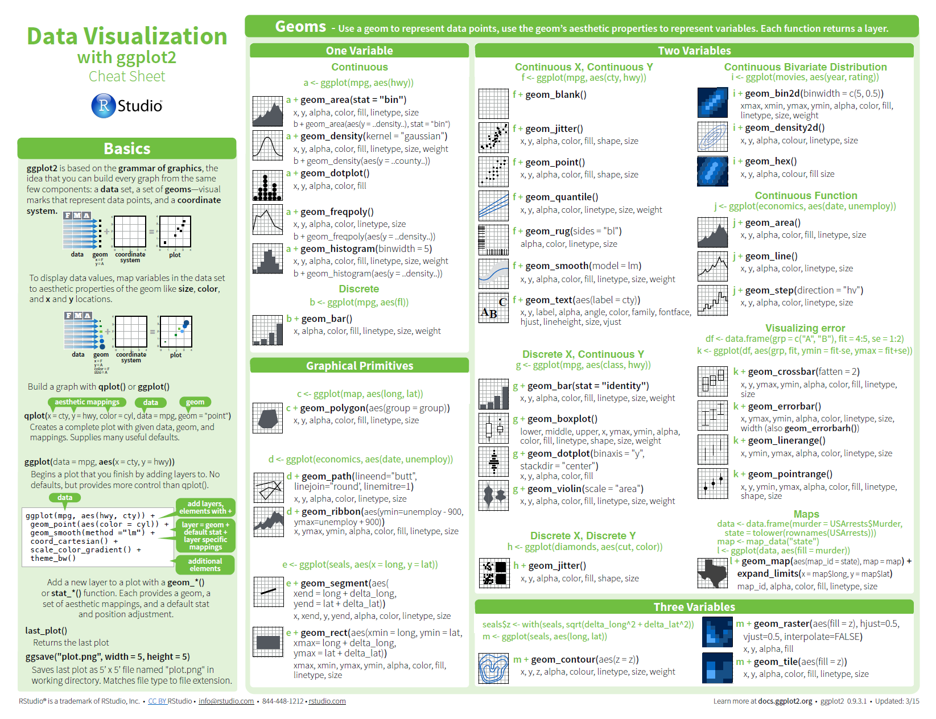
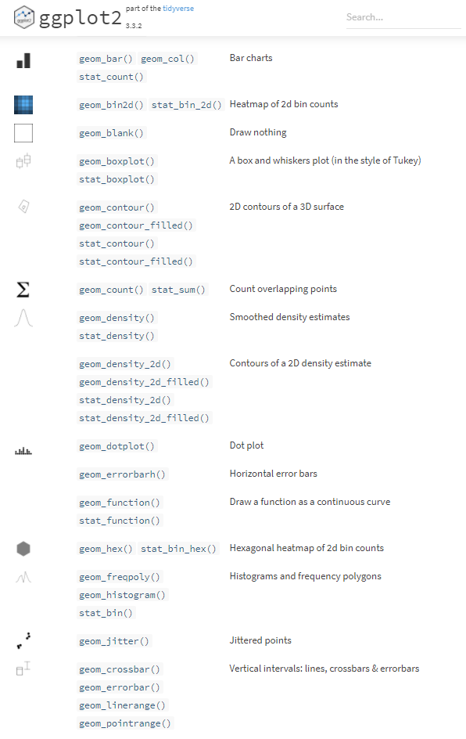
Geometric elements

Slide 13
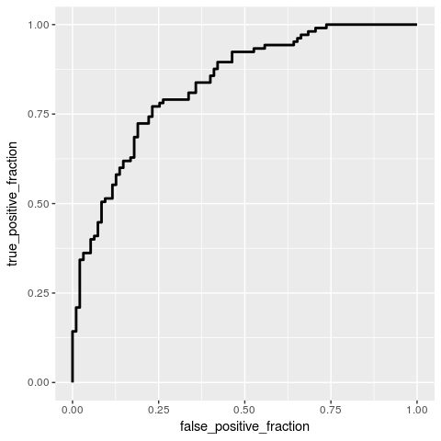
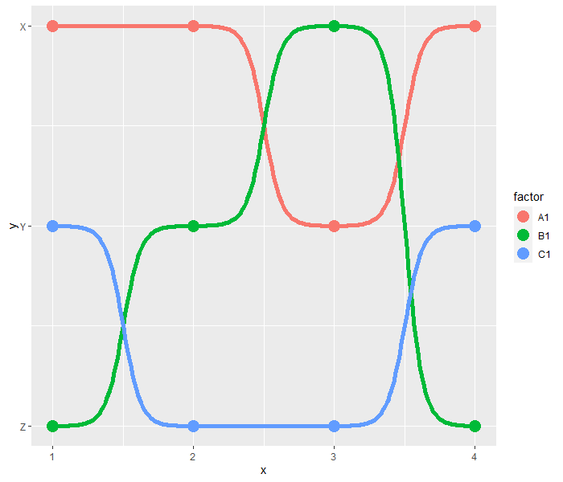
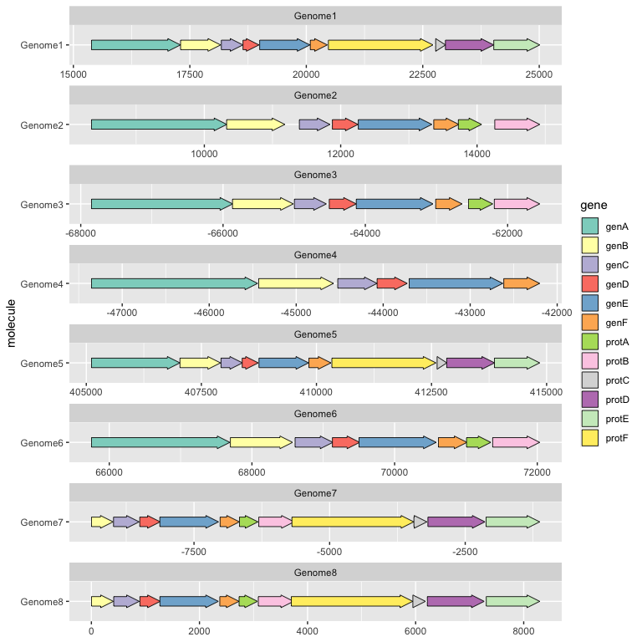
Geometric elements – extensions packages
plotROC package geom_roc()
ggbump package geom_bump()
gggenes package geom_gene_arrow()

Slide 14
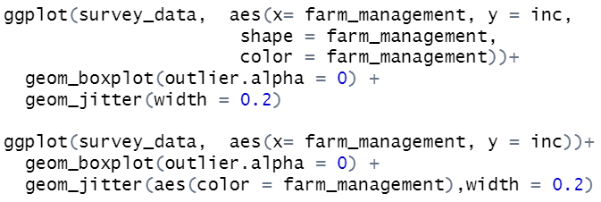
Aesthetics
How the variables will be mapped
Inside of aes() command
If aes() is in ggplot() function, the aesthetics will be the same for all geom_xxx()
If aes() is in a geom_xxx(), the aesthetics will be especificaly for that geom_xxx()
Most common
X and y-axis
Color; fill; and alpha
Shape
Size
Linetype

Slide 15
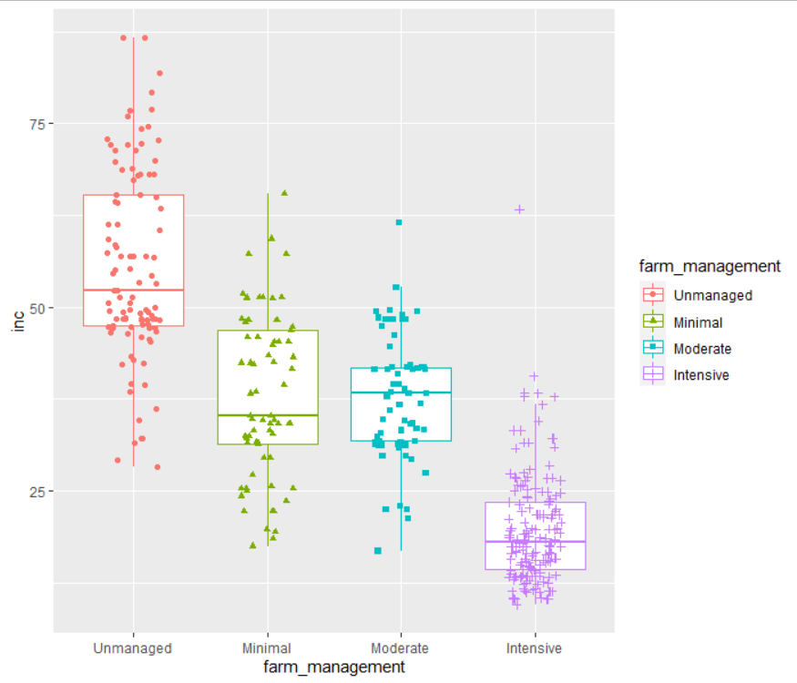
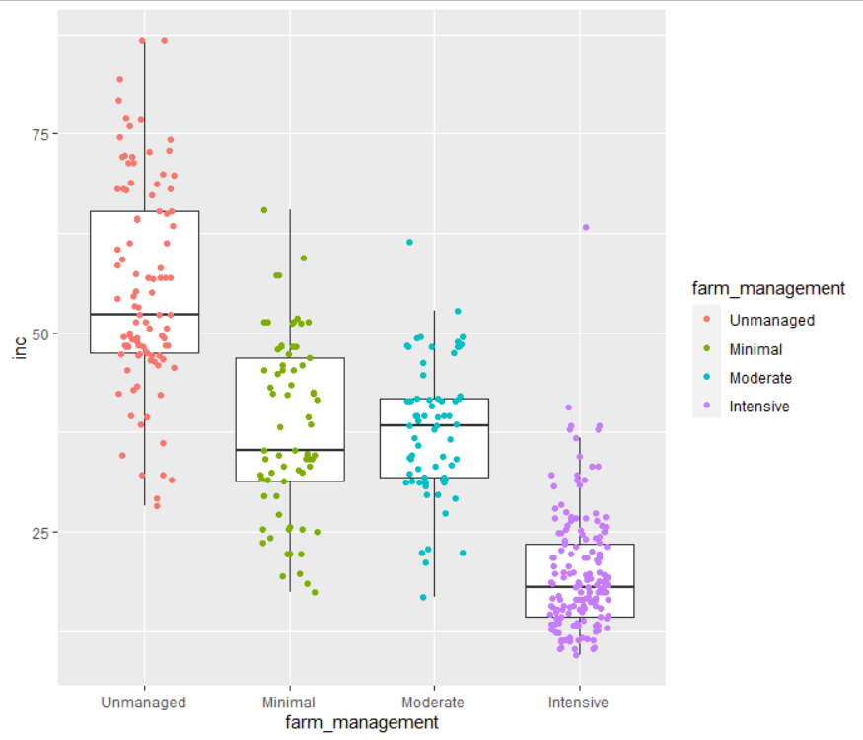
Aesthetics

Slide 16
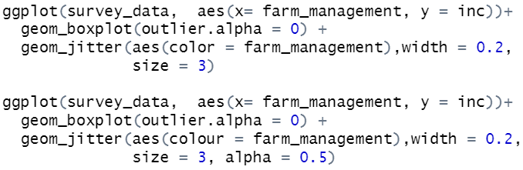
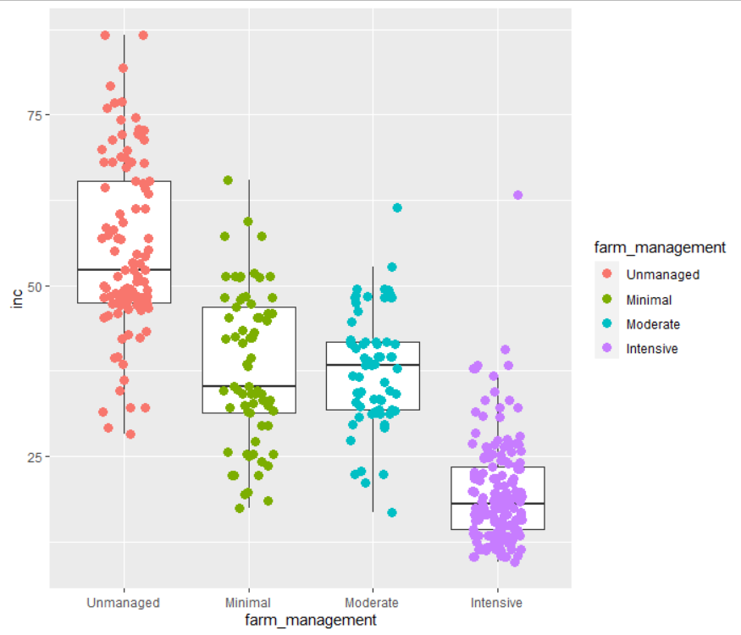
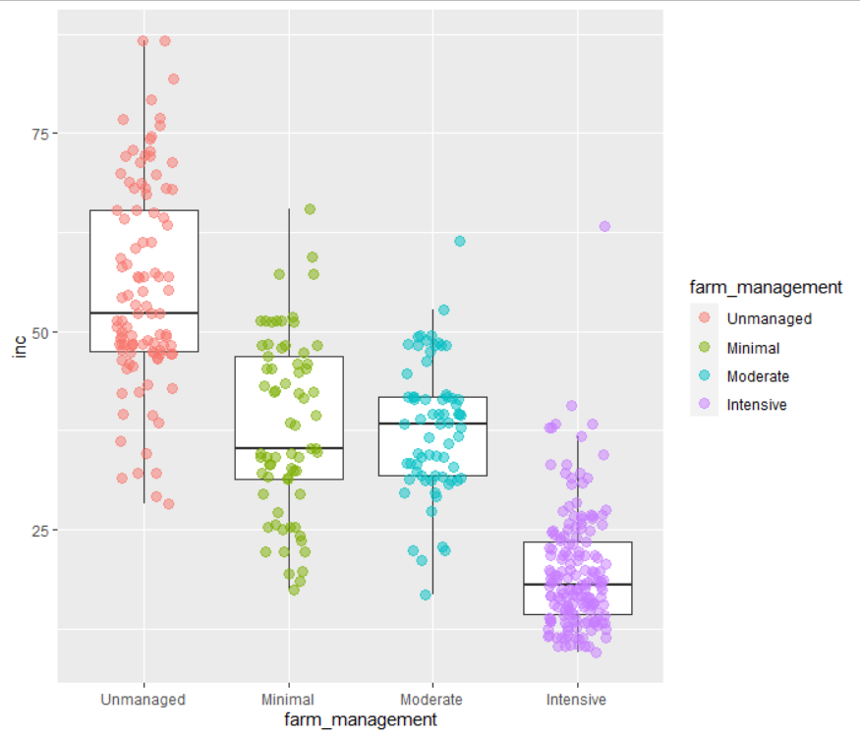
Aesthetics - color

Slide 17
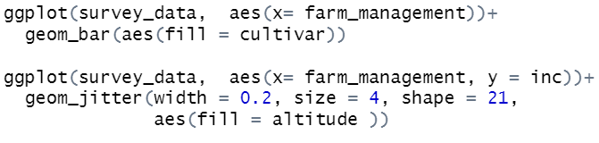
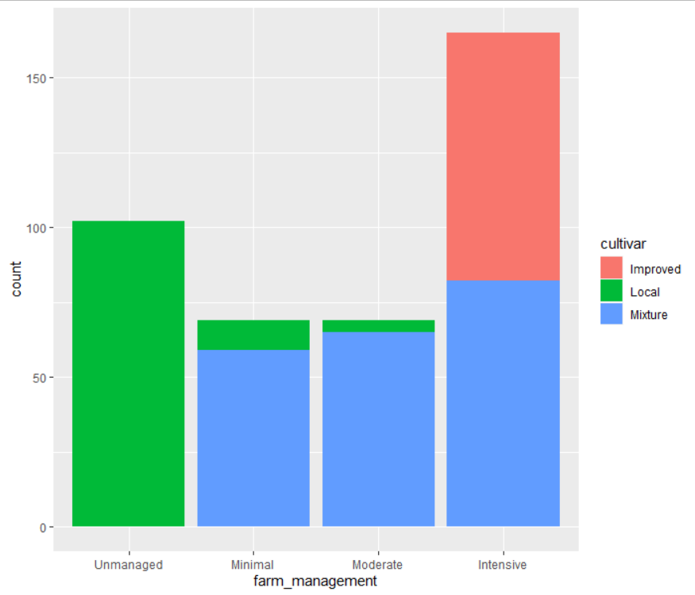
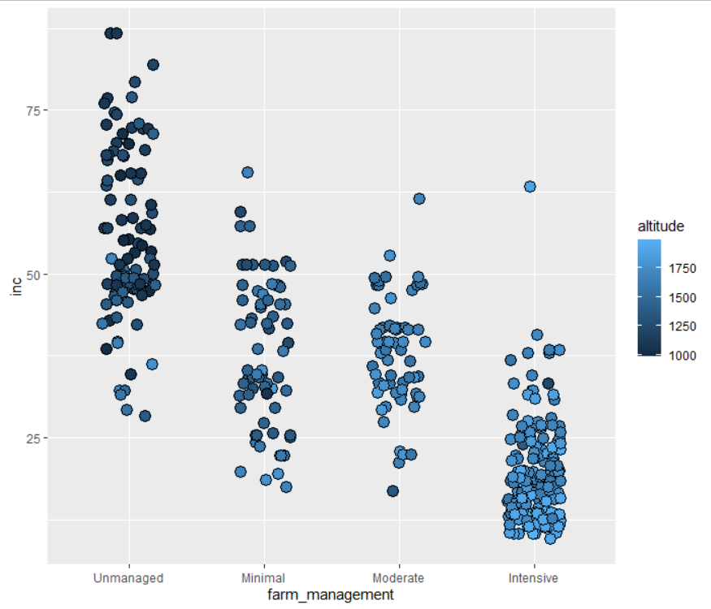
Aesthetics - Fill

Slide 18
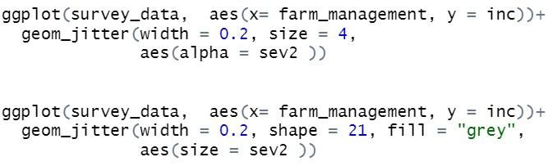
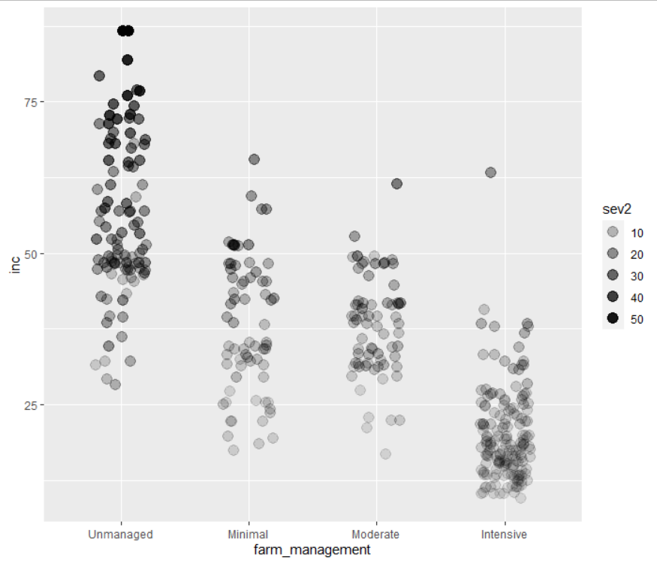
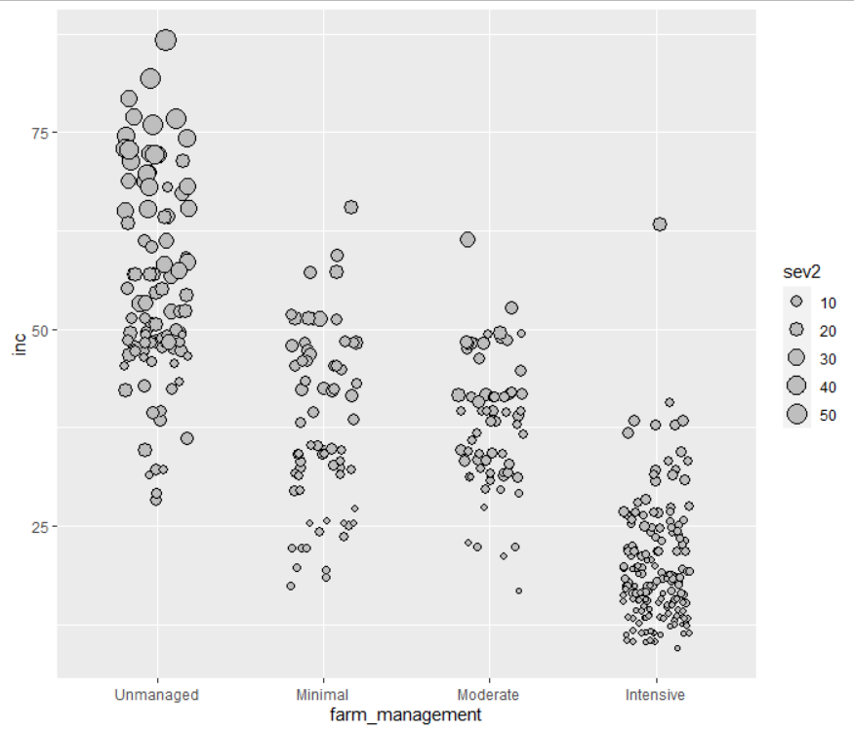
Aesthetics – Alpha and size

Slide 19
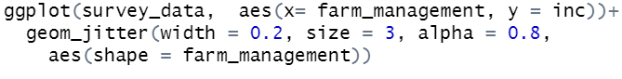
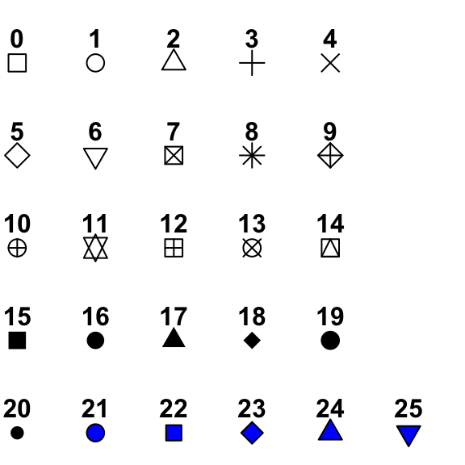
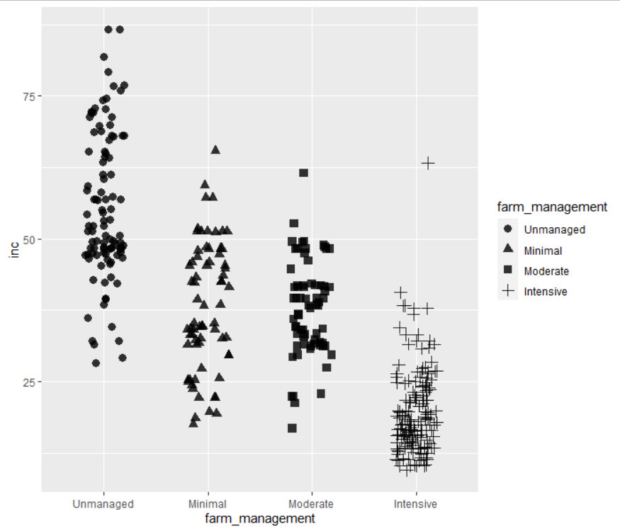
Aesthetics - shape

Slide 20
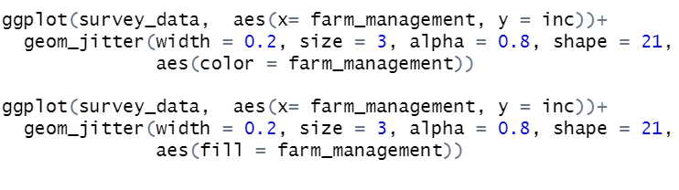


Aesthetics

Slide 21



Aesthetics

Slide 22


Scales
Control aesthetics mapping
Most common
scale_*_continuous()
scale_*_discrete()
scale_*_manual()
scale_*_date()
scale_*_reverse()
scale_*_log10()
scale_*_gradient2()

Slide 23





Scales
#RRGGBBAA

Slide 24



Scales
colorbrewer2.org

Slide 25






Scales
ggsci package
inauguration package

Slide 26




Scales
@CedScherer

Slide 27





What if we want the same plot with severity side-by-side?
Facets
Prepare a base plot
Prepare data

Slide 28



Facets

Slide 29


Facets

Slide 30


Labels

Slide 31




Themes

Slide 32



Themes
ggthemes package

Slide 33




Themes - customization
The options are countless

Slide 34

Themes - customization

Slide 35


Themes - customization

Slide 36


Save

Slide 37


Save

Slide 38


Save

Slide 39




Extra

Slide 40




Extra

Slide 41

The package grammar
DATA (survey_data_long) %>%
ggplot function –
Geometric elements (geom_boxplot and geom_jitter)
Aesthetic (x, y, and color)
Scale(y-continues and color [ggsci])
Facets (facet_wrap)
Themes(customized)
Save(ggsave – tiff, 85x140 mm)

Slide 42



Get inspired
Del Ponte, E. M., & Belachew, K. https://doi.org/10.17605/OSF.IO/XEJAZ
Belachew, K., Senbeta, G.A., Garedew, W. et al. Altitude is the main driver of coffee leaf rust epidemics: a large-scale survey in Ethiopia. Trop. plant pathol. 45, 511–521 (2020).
https://doi.org/10.1007/s40858-020-00383-4

Slide 43









Slide 44



Slide 45



Slide 46



@florencelydia11
@ijeamaka_a

